Slide 1
ECE 471/571 - Lecture 13
Gradient Descent
10/13/14

Slide 2
General Approach to Learning
Optimization methods
  Newton’s method
  Gradient descent
  Exhaustive search through the solution space
Objective functions
  Maximum a-posteriori probability
  Maximum likelihood estimate
  Fisher’s linear discriminant
  Principal component analysis
  k-nearest neighbor
  Perceptron

Slide 3
General Approach to Learning
Specify a model (objective function) and estimate its parameters
Use optimization methods to find the parameters
  1st derivative = 0
  Gradient descent
  Exhaustive search through the solution space

Slide 4
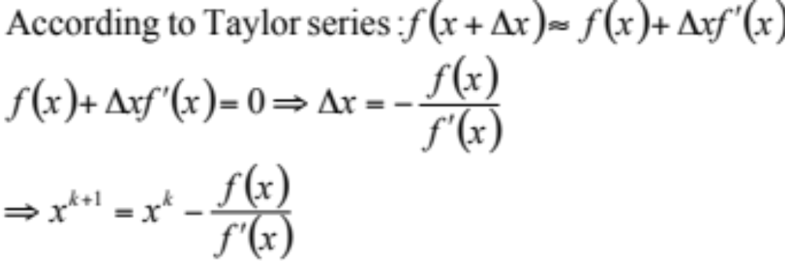
Newton-Raphson Method
Used to find solution to equations

Slide 5
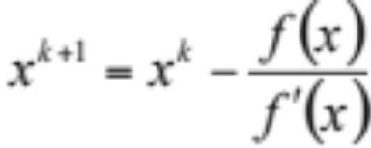
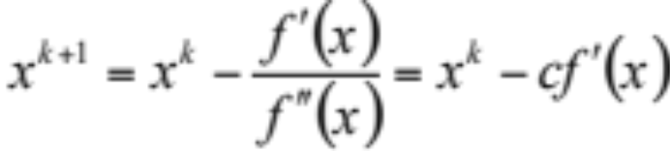
Newton-Raphson Method vs. Gradient Descent
f(x) = x² – 5x – 4
f(x) = xcosx
Newton-Raphson method
Used to find solution to equations
  Find x for f(x) = 0
The approach
  Step 1: select initial x0
  Step 2:
  Step 3: if |x^{k+1} – x^{k}| < ε, then stop; else x^{k} = x^{k+1} and go back step 2.
Gradient descent
Used to find optima, i.e. solutions to derivatives
  Find x* such that f(x*) < f(x)
The approach
  Step 1: select initial x0
  Step 2:
  Step 3: if |x^{k+1} – x^{k}| < ε, then stop; else x^{k} = x^{k+1} and go back step 2.

Slide 6
% [x] = gd(x0, c, epsilon)
% - Demonstrate gradient descent
% - x0: the initial x
% - c: the learning rate
% - epsilon: controls the accuracy of the solution
% - x: an array tracks x in each iteration
%
% Note: try c = 0.1, 0.2, 1; epsilon = 0.01, 0.1
function [x] = gd(x0, c, epsilon)
% plot the curve
clf; fx = -10:0.1:10; [fy, dfy] = g(fx); plot(fx, fy); hold on;
% find the minimum
x(1) = x0; finish = 0; i = 1;
while ~finish
[y, dy] = g(x(i));
plot(x(i), y, 'r*'); pause
x(i+1) = x(i) - c * dy;
if abs(x(i+1)-x(i)) < epsilon
finish = 1;
end
i = i + 1;
end
x(i)
% plot trial points
[y, dy] = g(x);
for i=1:length(x)
plot(x(i), y(i), 'r*');
end
function [y, dy] = g(x)
y = 50*sin(x) + x .* x ;
dy = 50*cos(x) + 2*x;

